Slide 1

Lecture 5
Building!

Slide 2
Topics
Prototyping
Embodiment Design
Tool: Figma

Slide 3


Slide 4
Where It Can Get Confusing
No overarching definition for prototyping
Each industry/company/field have different methods

Slide 5
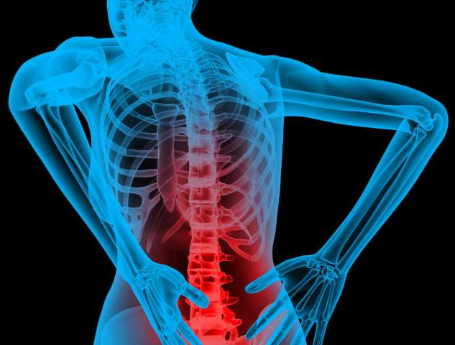
Prototyping Backbone
Identify these:
Purpose
What you are testing
Scale
Integration level
Logistics
Embodiment.
Data gathered
Create Plan of Action
What you are going to do
How you are going to do it
What are you using to evaluate your prototype
Do it
Evaluate and Reiterate

Slide 6
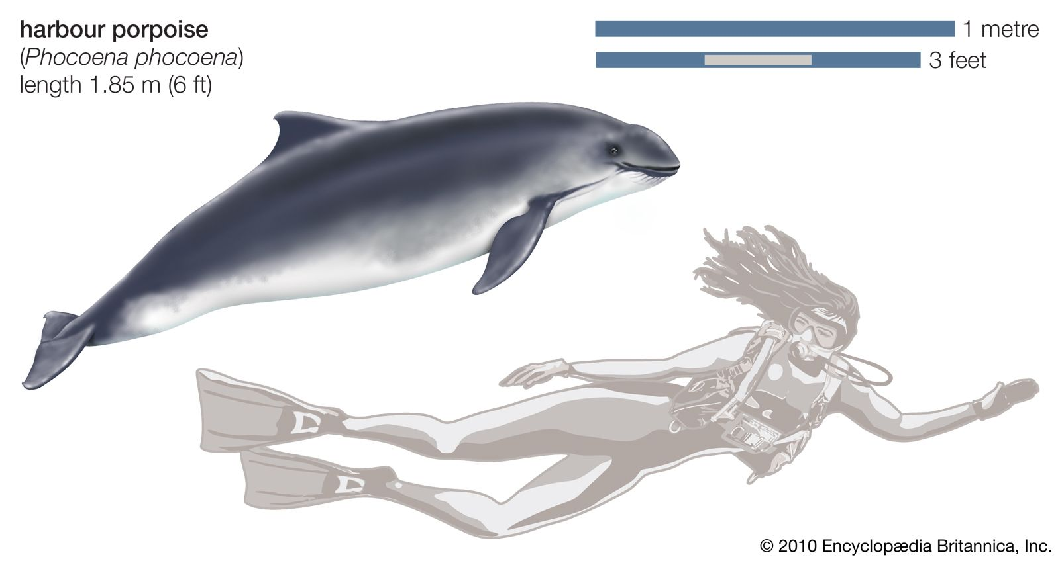
Identify Prototype Purpose
Learn Something:
Proof of Concept (aka does it work)
Compare ideas
Feasibility
Generate Ideas
Potential Problems
Communicate:
Communicate/demonstrate something to stakeholders
Integration:
Ensure components/subsystems work together
Milestone:
Demonstrate product meets a desired level of functionality
prototype
prototype

Slide 7
What Are You Testing?
User Needs
How does it address users needs
User Experience
The user’s experience
Look and Feel
What shape/form it takes
How it looks
Nuts and Bolts
How it works
Quality
Quality of materials
Durability
¯\_(ツ)_/¯

Slide 8
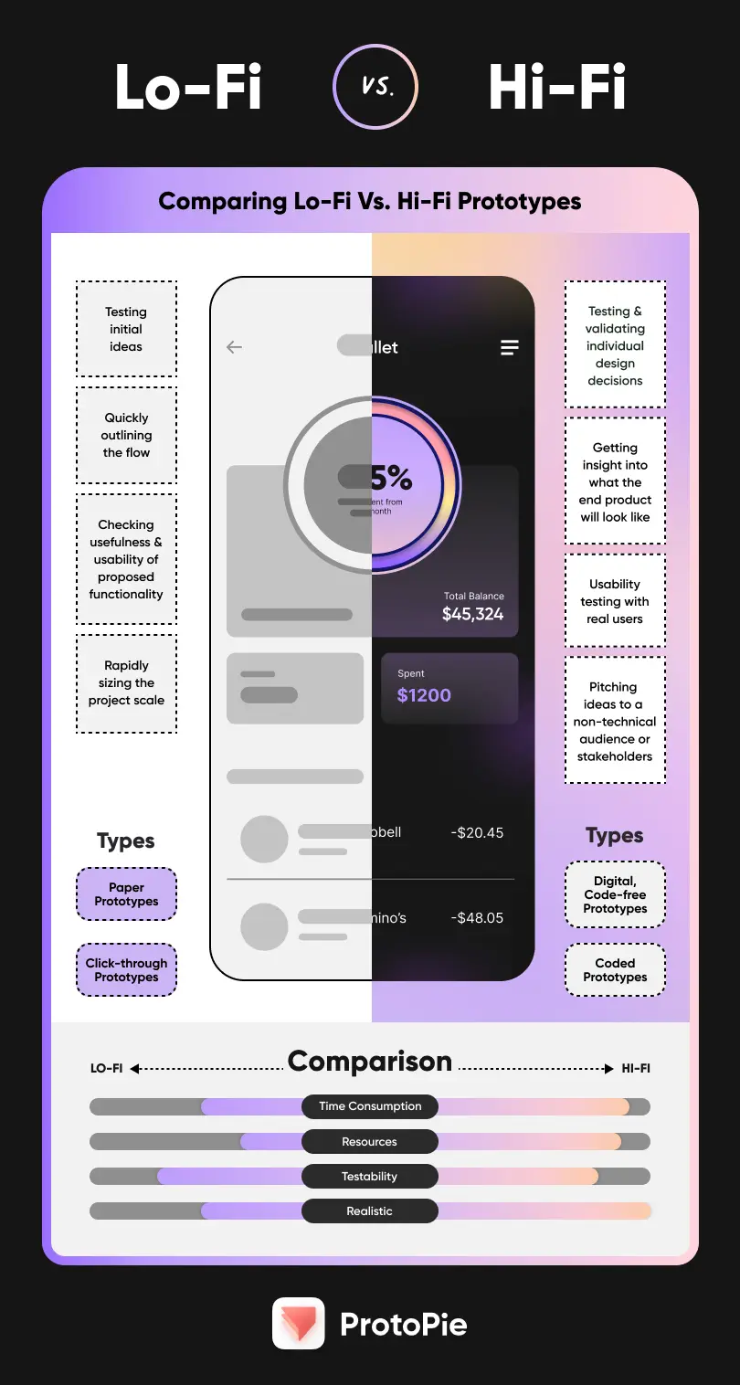
Scale
High Fidelity vs Low Fidelity
High Fidelity: detailed and specific
Low Fidelity: low amount of details
Full scale vs Scaled
Full Scaled: same size and number of parts as final implementation
Scaled: smaller/fewer parts than final implementation
Cheaper
Faster

Slide 9

Integration Level
Sub-System vs Entire System
Sub-System: better when interactivity less important
Entire System: best when interactivity important
$$\int_{0}^{555}{(LEVEL)}dy$$

Slide 10
Logistics
Cost Constraints vs No-cost Constraints
No cost constraints create more creative solutions but also take more time
Resource Constraints vs No-Resource Constraints
How many prototypes can you make
Parallel Concepts vs Single Concepts
Parallel: can resolve uncertainty by presenting multiple models for evaluation and is generally faster
Single: Allows for learning and improvement between tests

Slide 11
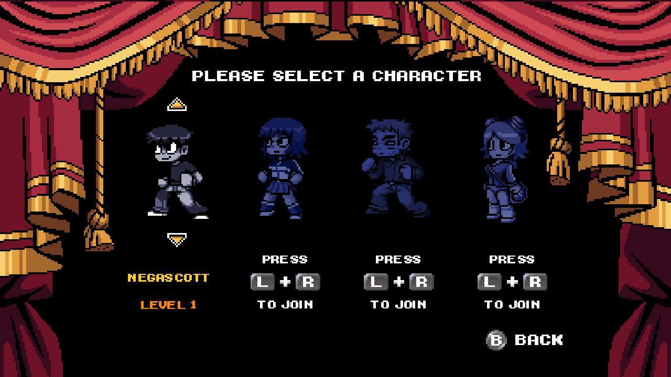
Embodiment
Virtual vs Physical
Virtual: cheaper and faster
Physical: values virtual can’t replicate, real world implementation
Test Materials vs Final (manufacturing materials)
Will depend on how close to product deployment

Slide 12
Data Gathered
Before testing decide what data, you will be testing for
Decide the methods and techniques for gathering this data
Plan these methods with statistical analysis
Easier to extrapolate data without using statistics
Harder to try and find useful data in non statistical based methods using statistics

Slide 13
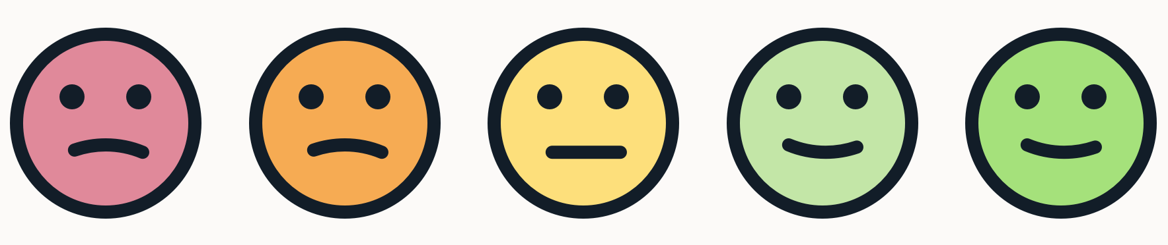
Evaluate
Record Outcomes:
Make sure to document all results and data from your prototype testing.
Evaluation:
Engage with team members or stakeholders to evaluate the prototype's performance.
Use both qualitative and quantitative measures.
Analyze:
Go beyond just the surface results. Dive deep into the data and think analytically about what it means.
Brainstorming Session:
Now is an excellent opportunity to brainstorm further improvements or changes based on the data gathered.
Wins and Losses:
Identify what aspects of the prototype worked well (wins) and what didn't (losses). This will help in refining the next iteration.

Slide 14

Reiterate
Data Collection:
Determine if there's additional data required that wasn't collected in the initial tests.
Improvement Points:
Based on the outcomes, brainstorm on how the prototype can be improved.
Learning Opportunity:
Every prototype, whether successful or not, provides a learning experience. Reflect on the lessons learned during this phase.
Whenever needed prototype again!

Slide 15

Pitfalls to avoid
Diving into the first idea
Brainstorm, explore broad range, use low fidelity first
Fall in love with your prototypes
Start with low fidelity having just enough level of detail
Waste time explaining and pitching
Show don’t explain
Prototyping without a purpose
Become discouraged by failure

Slide 16

Embodiment Design
Where the design concept is given form, ending with a working model, technically and visually complete designed to meet CR’s and EC’s
Establish product architecture:
Arrange the functional elements of product into physical units
Consider modularity and integration
Configuration Design:
Establish the shape and dimensions of the components
Preliminarily select materials and manufacturing processes
Design with manufacturing considerations in mind
Parametric Design:
Refinement to set critical design variables
Enhance robustness of design
Optimize critical dimensions and set tolerances
T

